Slide 1


Total monthly expenditure on food services in Australia, April 1980 – April 2015
Time Series Project by:
Daniel Sánchez Pagán
David Bravo Pérez
David Valcárcel Herrera

Slide 2
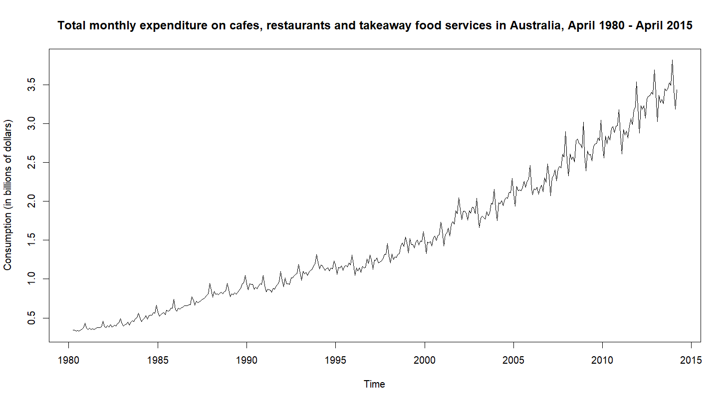
Data exploration
There is a trend component
The variance is not constant
There are signs of seasonality

Slide 3
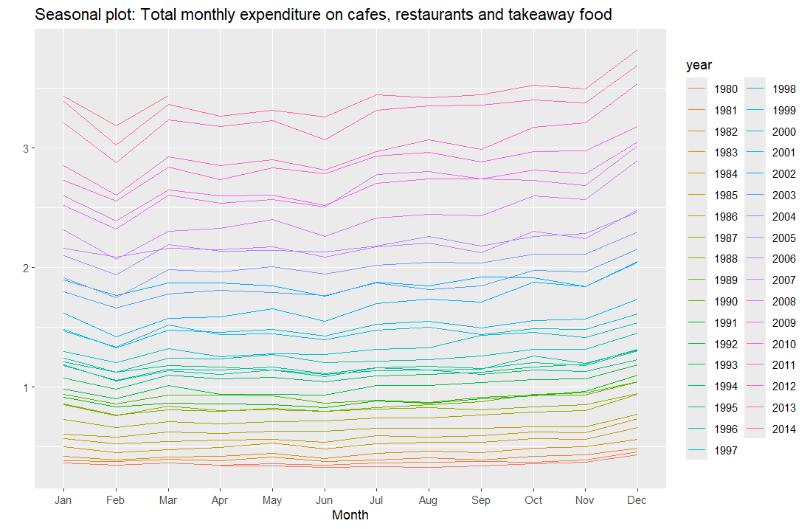
Seasonality of the data
As the data consist of monthly observations, we can assume a yearly seasonality. Then, we have:
Period s=12
Variance not constant, it increases over time
Trend component, higher values every year

Slide 4
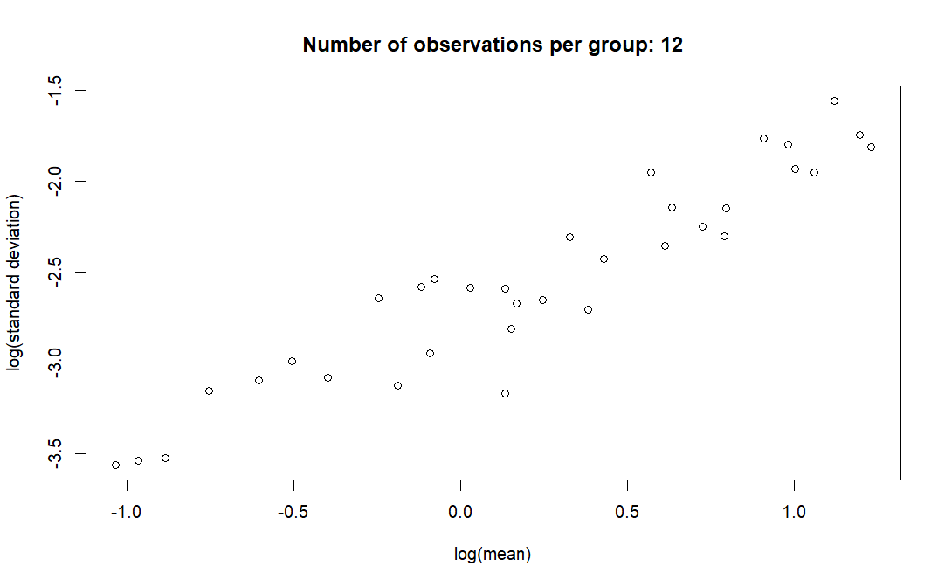
Box-Cox transformation
We can see a linear relationship between the logarithms of standard deviation and mean of each year, so we can apply the Box-Cox transformation

Slide 5
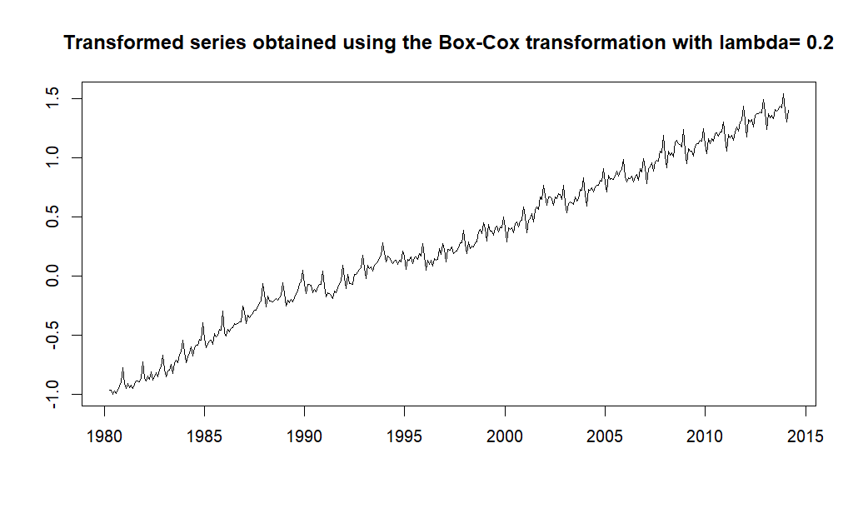

Transformed series $\left\{{\tilde{X}}_{t}\right\}=(X_{t}^{λ}−1)/λ$
λ
As lambda = 0.2, it’s not close enough to zero to consider the logarithm of the time series.
The variance of the series is now stabilized.

Slide 6
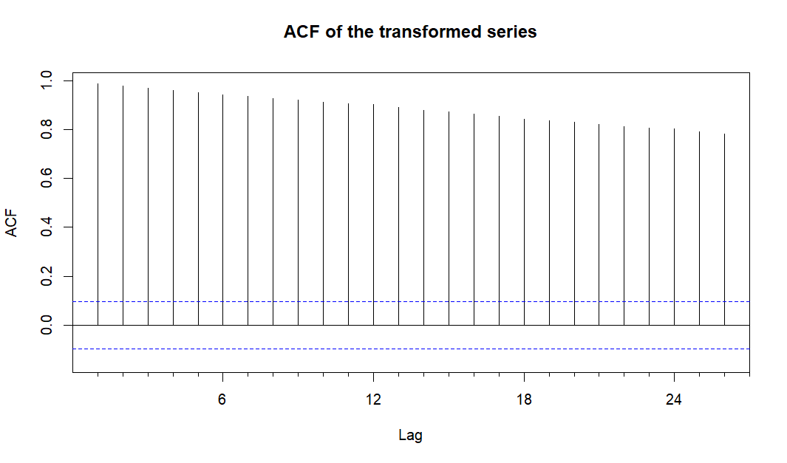
ACF of the transformed series
The decrease in the coefficients of the ACF suggests us to make a regular differentation.

Slide 7
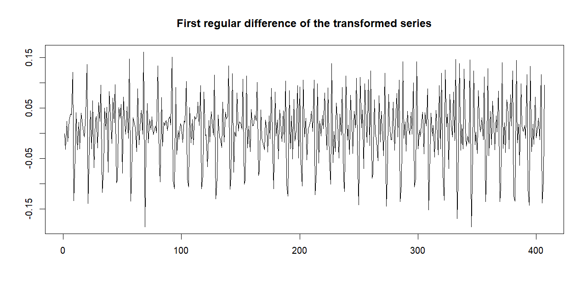

Series {$W_{t}$}$=\left\{∇{\tilde{X}}_{t}\right\}=\{{\tilde{X}}_{t}−{\tilde{X}}_{t−1}\}$
Now, the mean is constant and zero (0.005809344). So there is no need to keep differentiating.

Slide 8
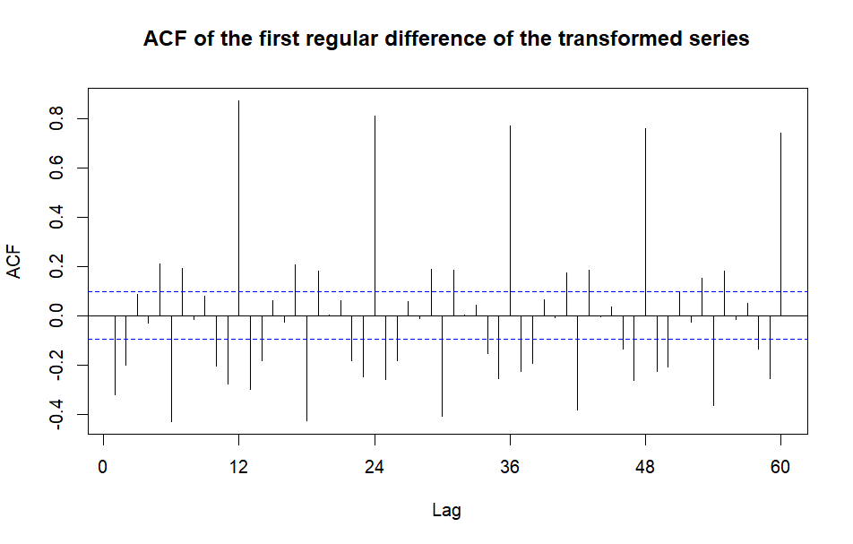

ACF of series {$W_{t}$}
We can see the effect of seasonality in the lags 12, 24, 36,…
We will make a seasonal differentation

Slide 9
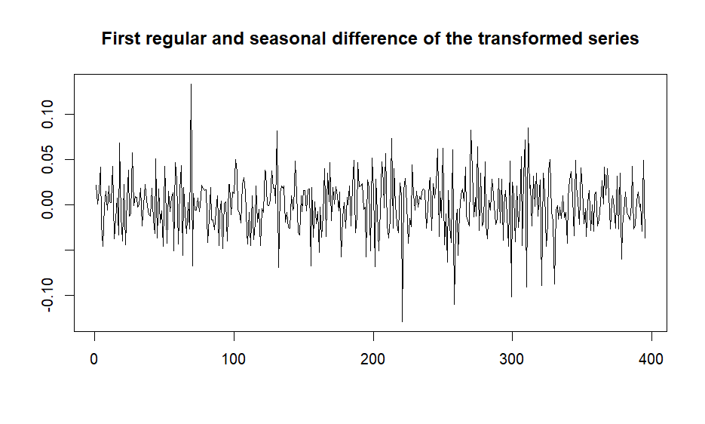


Series {${\tilde{W}}_{t}$}$={\{∇}_{12}W_{t}\}$, where $∇_{12}=1−B^{12}$
Now, the series {${\tilde{W}}_{t}$} is stationary (mean zero and constant variance).
We will proceed to analyze the ACF and PACF to determine the possible models.

Slide 10
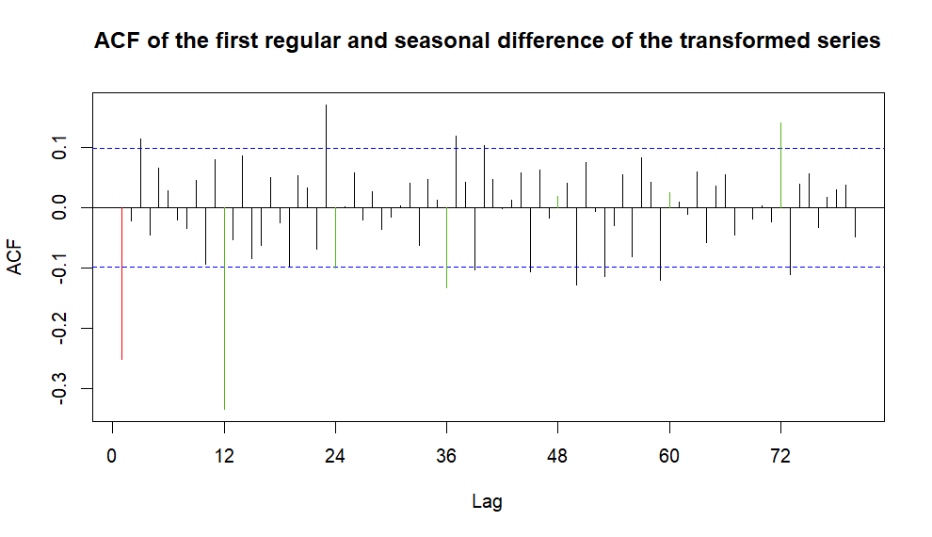

ACF of series {${\tilde{W}}_{t}$}
We can consider only the first coefficient different from zero or it could be a geometrical decrease.
We can consider the first three seasonal lags as different from zero.

Slide 11
Possibilities from ACF
Regular:
The only first coefficient different from zero suggests MA(1)
Because of the geometrical decrease we can have AR
Seasonal:
The only three coefficients different from zero suggest MA(3)

Slide 12
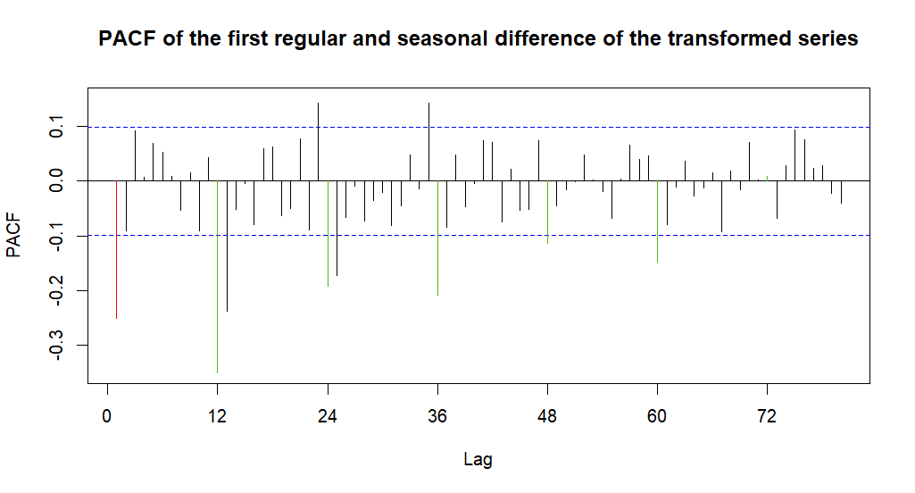

PACF of series {${\tilde{W}}_{t}$}
We can consider only the first coefficient different from zero or it could be a geometrical / sinusoidal decrease.
We can consider the first five seasonal lags as different from zero or a geometrical decrease.

Slide 13
Possibilities from PACF
Regular:
The only first coefficient different from zero suggests AR(1)
We can have MA based on the geometrical / sinusoidal decrease
Seasonal:
The only five coefficients different from zero suggest AR(5)
Based on the geometrical decrease we can have AR

Slide 14
Suggested models
Model 1: ARIMA(3,1,1)₁₂x(2,1,1)
Model 2: ARIMA(5,1,1)₁₂x(2,1,1)
Model 3: ARIMA(3,1,1)₁₂x(3,1,1)
Model 4: ARIMA(2,1,2)₁₂x(0,1,1)
Model 5: ARIMA(3,1,1)₁₂x(0,1,1)
Model 6: ARIMA(3,1,2)₁₂x(0,1,1)
Model 7: ARIMA(3,1,1)₁₂x(1,1,0)

Slide 15
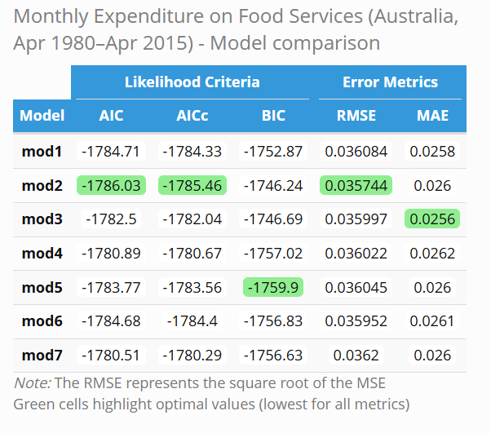
Search of best models
Choosing the best models for each metric, we select models 2, 3 and 5.

Slide 16
Diagnosis of residuals
Non Parametric Tests
Turning Point Test | Difference-sign test | Rank test | Ljung-Box Test (k=24)
 | Statistic | P-value | Statistic | P-value | Statistic | P-value | Statistic | P-Value
Model 2 | 0.03922624 | 0.96871001 | 1.79853241 | 0.07209268 | 0.26016592 | 0.79473579 | 28.940 | 0.0106
Model 3 | 0.4314887 | 0.6661131 | 0.4282220 | 0.6684895 | 0.2267368 | 0.8206284 | 30.522 | 0.0101
Model 5 | 0.6668462 | 0.5048704 | 0.0856444 | 0.9317491 | 0.1671457 | 0.8672554 | 43.139 | 0.0007
The p-value of Ljung-Box Test for the model 5 is way lower than the rest. Non parametric tests don’t give us enough information.

Slide 17
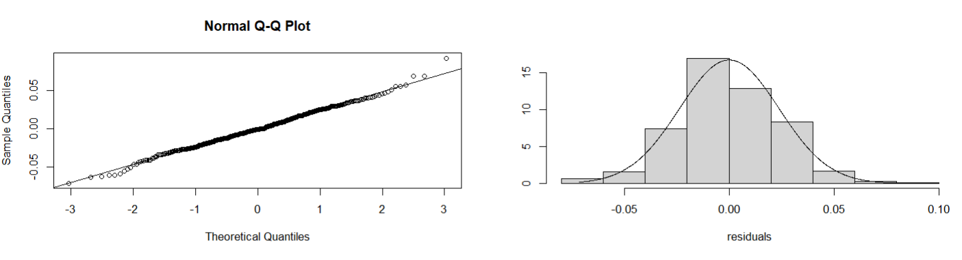

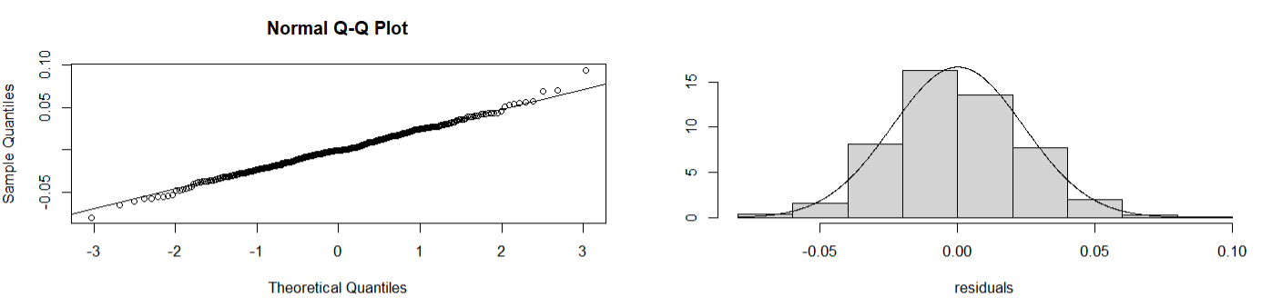

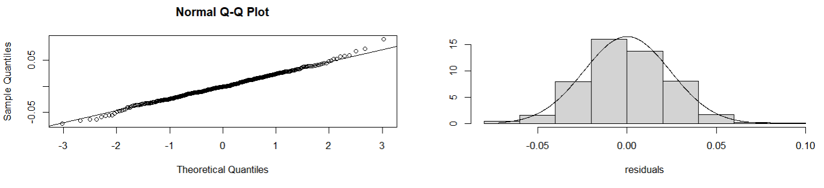

Normality of residuals
Model 2
Model 3
Model 5

Slide 18
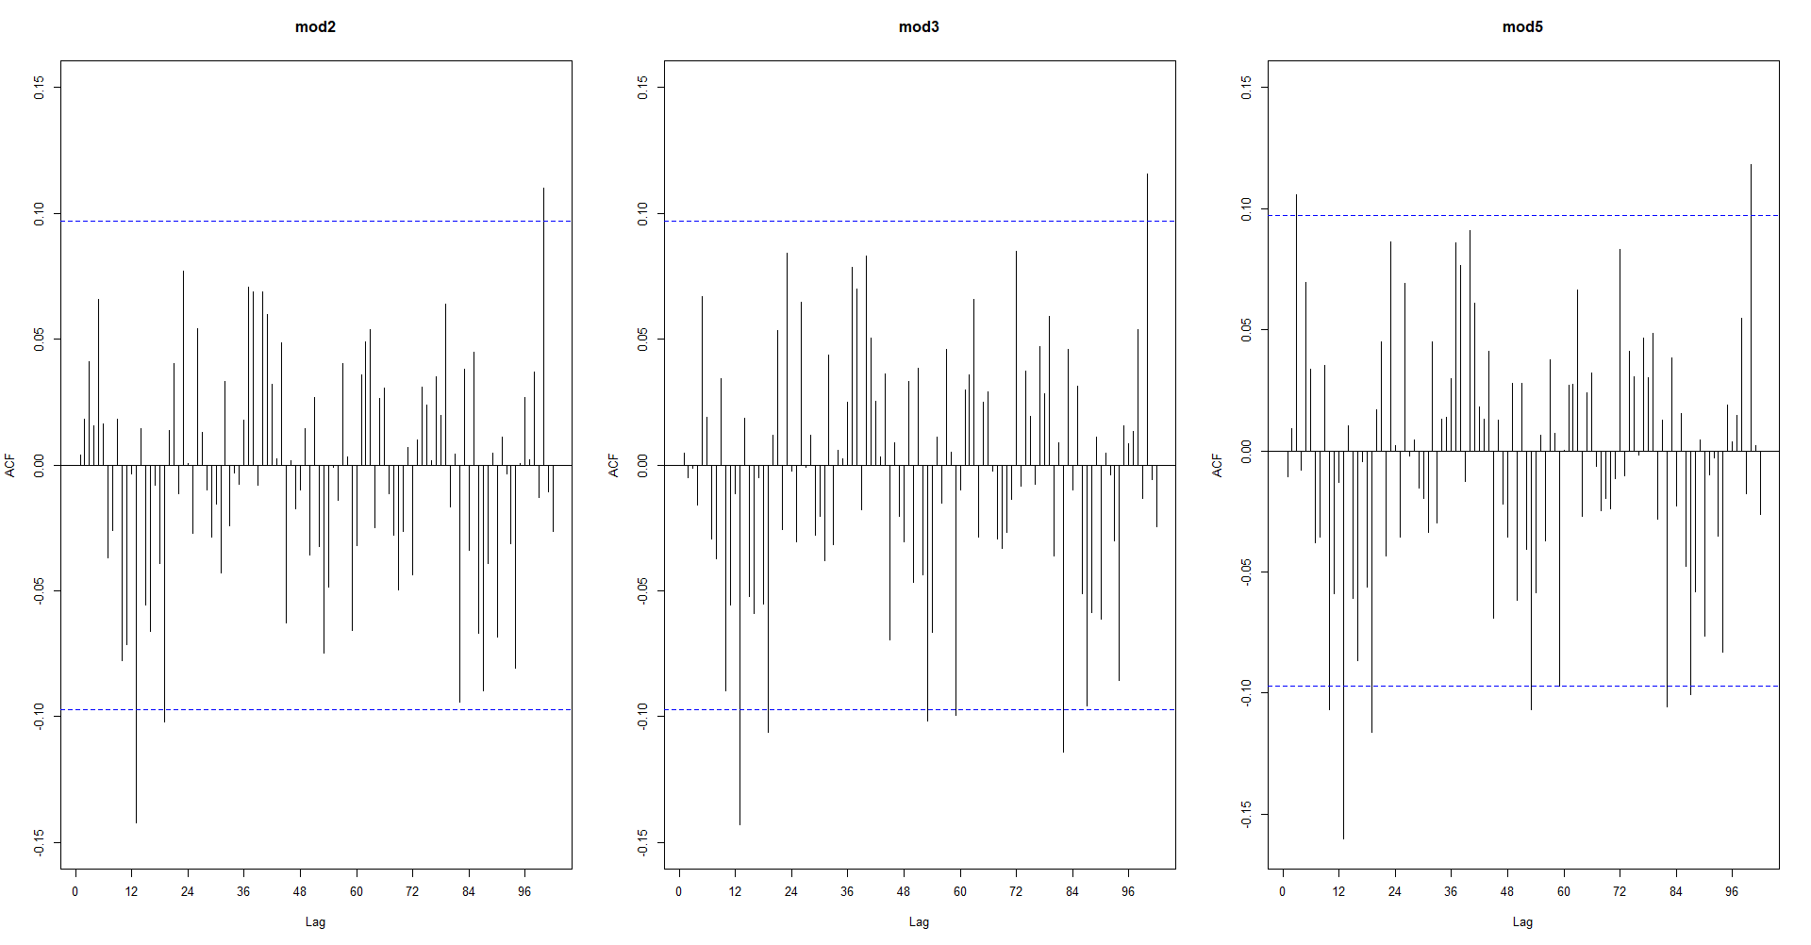
Sample ACF Test
n=408
h=n/4=102
Bound=+-0,099
Model | Number | %
2 | 3 | 2,94
3 | 6 | 5,88
5 | 8 | 7,84

Slide 19

Conclusions
By Ljung-Box Test we discard the model 5, so the two final models are model 2 and model 3.
Model 2 is the only one that passes the ACF sample test
Because of its parameters, model 2 is a lot more complex than model 3, with a high computational complexity. With that in mind, model 3 has a performance very similar to model 2 but has a structure much simpler.
The final chosen model will be model 3 $\left\{{\tilde{X}}_{t}\right\}={(3,1,1)}_{12}$x$(3,1,1)$ represented as: $\left(1−0.0057B^{12}−0.1352B^{24}−0.1772B^{36}\right)\left(1+0.1896B+0.0776B^{2}+0.1275B^{3}\right)\left(1−B^{12}\right)\left(1−B\right){\tilde{X}}_{t}=$ $Y_{t}(1−0.5273B)(1−0.7237B^{12})$

Slide 20
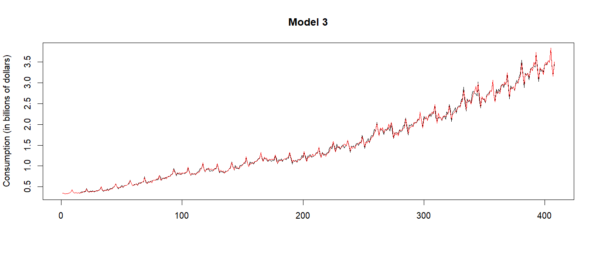
Validation of the model
--- Observations
--- Fitted values

Slide 21
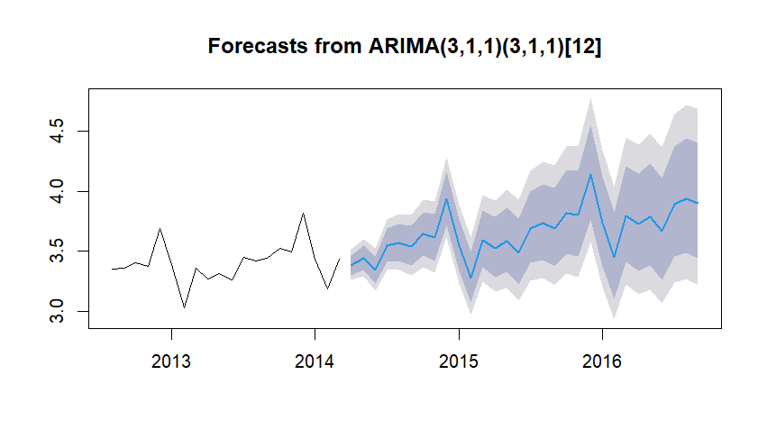
Forecast

